Slide 1
Ironhack Data analysis Final project
Predict Spotify track popularity score
By Tom DUBUN
November 2021

Slide 2
Objective
This project is the last project undertaken at IronHack. It aims at :
understanding the song patterns of French artists’ music
digesting the drivers of a song popularity on spotify to build machine learning algorithms to predict song popularity

Slide 3
Database creation
Kaggle: Database of 1m+ artists and gender → extracted only French artists into hip hop, pop, rock or electro genre → 12k artists
Spotipy package to get:
10 most popular tracks per artist
Spotify API to get
audio features of each song
their release date
presence or not in a Spotify France own playlist
artists spotify users’ followers
→ The final dataframe contains 20k+ unique tracks and 17 associated features + track_popularity (#Target)

Slide 4
Features (1/2)
popularity: spotify calculated popularity score of the track. This is the target variable
artist_followers: number of followers an artist has on spotify
in_spotify_fr_playlists: indicates the presence of the track in a spotify published playlist (french market)
danceability: Danceability describes how suitable a track is for dancing based on a combination of musical
instrumentalness: Predicts whether a track contains no vocals.
acousticness: A confidence measure from 0.0 to 1.0 of whether the track is acoustic. 1.0 represents high confidence the track is acoustic
speechiness: presence of spoken words in a track. The more exclusively speech-like the recording (e.g. talk show, audio book, poetry), the closer to 1.0 the attribute value.
duration_s: length of the track (in second)
artist_genre : the dominant genre associated to the artist

Slide 5
Features (2/2)
key: The key the track is in
valence: A measure from 0.0 to 1.0 describing the musical positiveness conveyed by a track.
tempo: The overall estimated tempo of a track in beats per minute (BPM).
time_signature: An estimated overall time signature of a track. The time signature (meter) is a notational convention to specify how many beats are in each bar (or measure).
loudness: The overall loudness of a track in decibels. Values typical range between -60 and 0 db.
mode: the modality (major or minor) of a track, the type of scale from which its melodic content is derived. Major is represented by 1 and minor is 0.
release_year: the year the track was released (based on the album release date)
era: era in which the track was released (based on release_year)

Slide 6
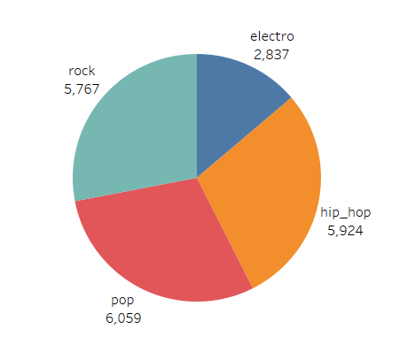
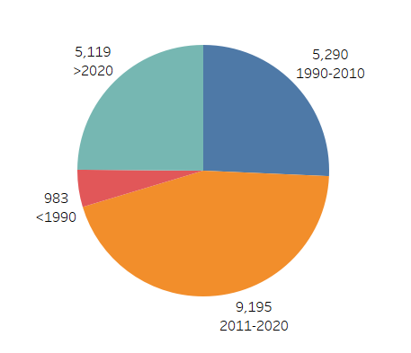
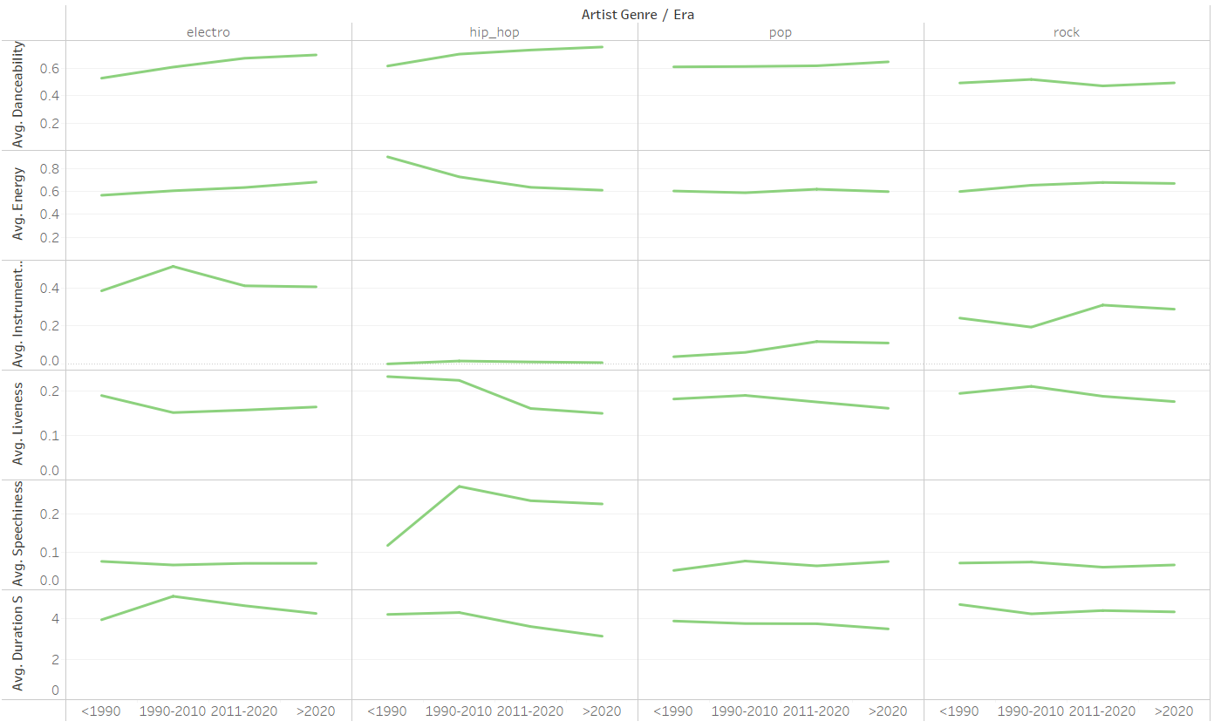
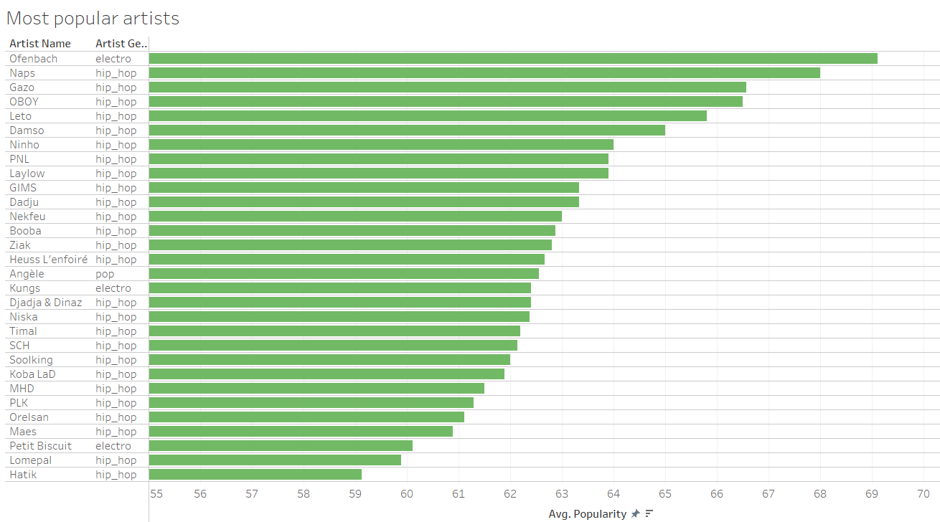
Database exploration (1/2)

Slide 7
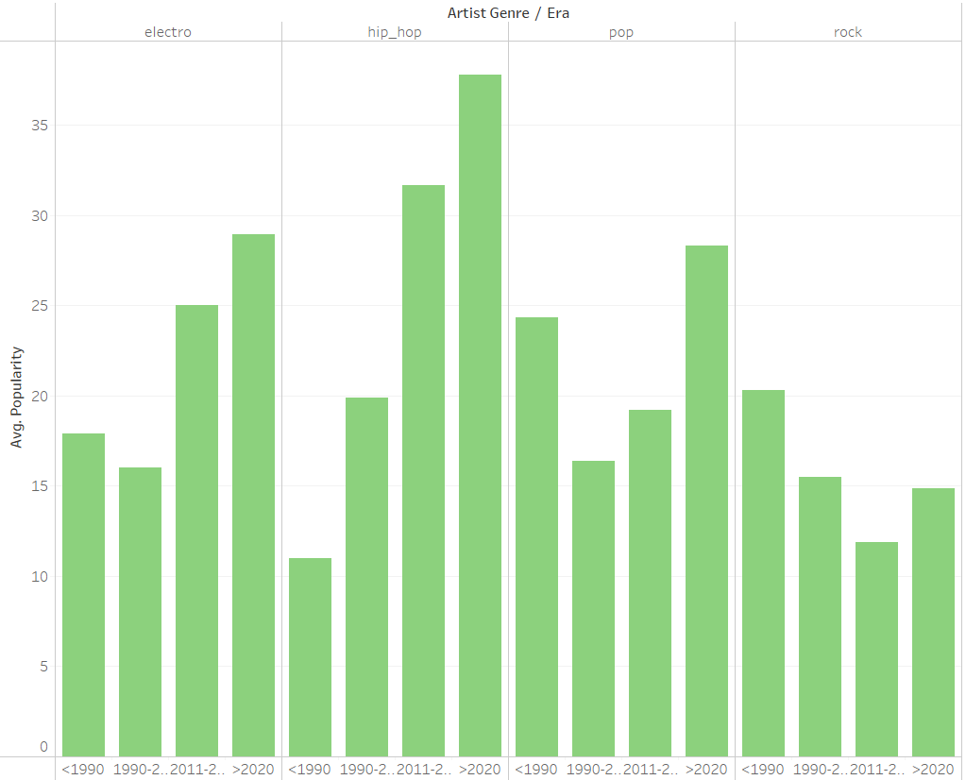
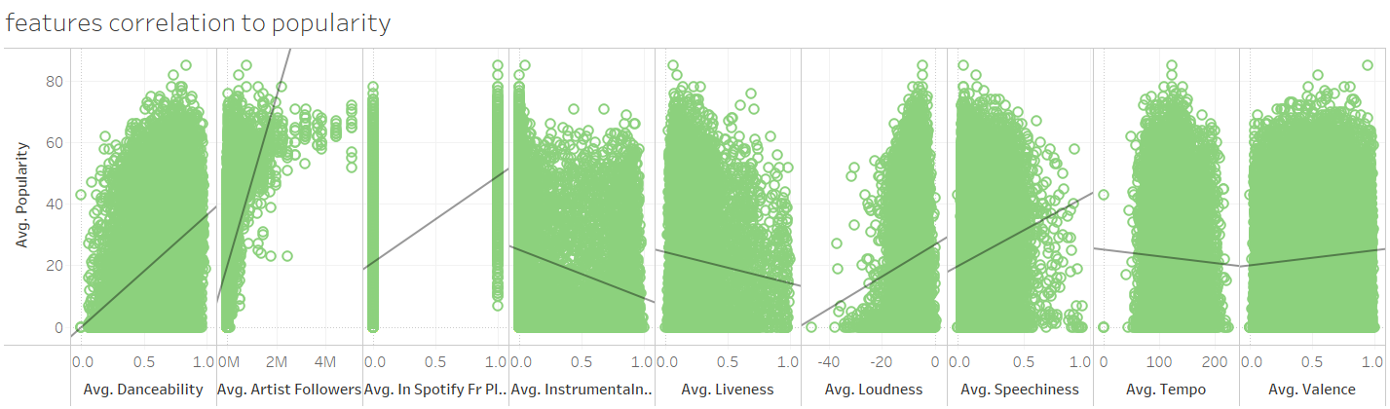
Database exploration (2/2)

Slide 8







Most popular french artists

Slide 9
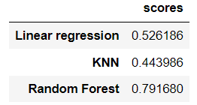
Machine learning algorythms
Linear regression:
Removed outliers
Normalized numericals
Encoded categoricals
K-nearest neighbors:
Removed outliers
Normalized numericals
Encoded categoricals
Found best k
Random Forest:
Normalized numericals
Encoded categoricals
Hyperparameter tuning

Slide 10
Future work
Find other features that could help predicting track popularity such as
lexical field of each song
fan engagement (festivals, social media…)
affiliation to a label/major
Diversify sources of information (not only Spotify)
Integrate a sub-model to best predict non established artists. As of now, the algorithm will easily predict song popularity for artists having many spotify users’ followers
Make the model universal and not solely applicable to the French market

